Slide 1

XReality: Update S2019 Augmented | Virtual | Mixed
Lukas Garcia
Rachel St. Claire, Gwen Field
Tony Stracuzzi, Vinny Macri

Slide 2
Table of Contents
What is XReality?
What is Augmented Reality?
What is Virtual Reality?
What is Mixed Reality?
CyclePsych
Project Lead: Rachel St. Claire
Stress in Virtual Reality
Project Lead: Toni Stracuzzi
Educational Mixed Reality
Project Lead: Vinny Macri
S.S.D.M. in VR
Project Lead: Lukas Garcia
VRmancer (WIP/Private)
Project Lead: Lukas Garcia

Slide 3
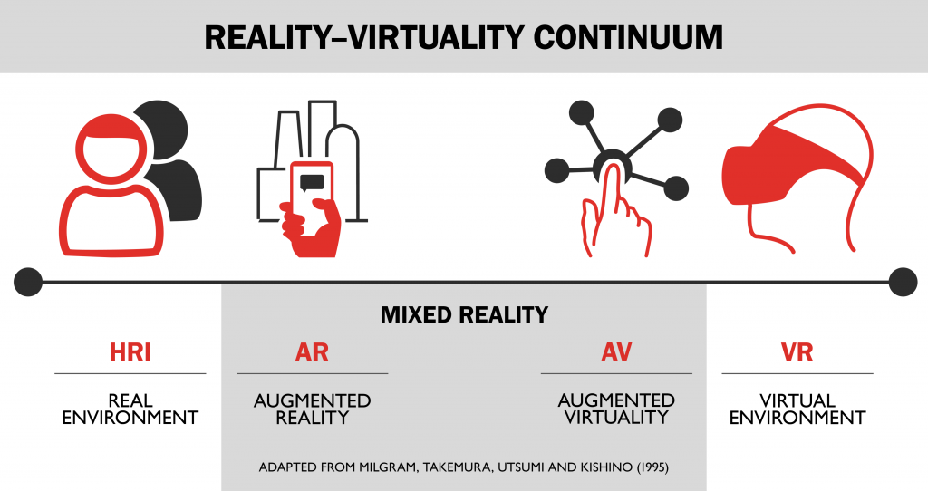
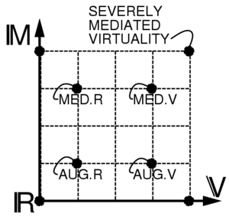
What is XReality (XR)?
The Reality-Virtuality Continuum
An umbrella that holds it all together
A scale that ranges from the completely real to the completely virtual.
Concept proposed by Paul Milgram¥

Slide 4
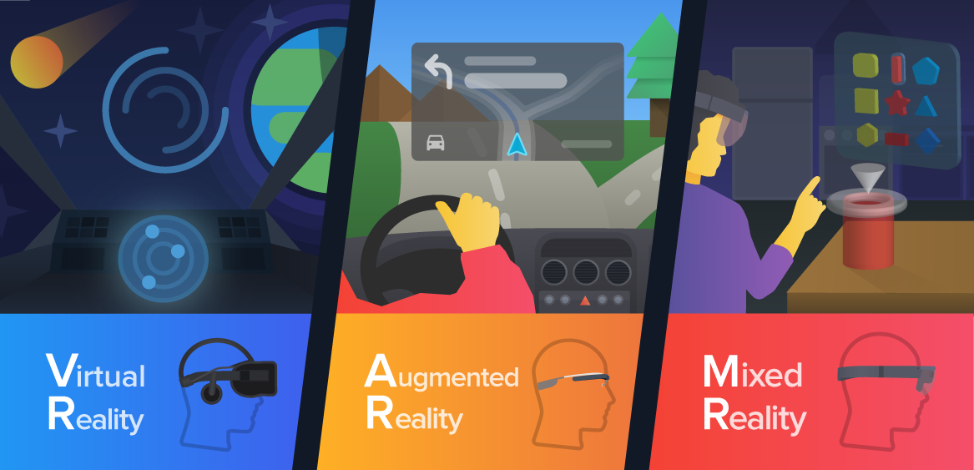
What is the biggest difference?
Depends on how the user is interacting with the different reality compared to the real world.
How does the user interact with the virtual? The objects?
Environment, objects, NPCs, the 5 senses, etc.

Slide 5
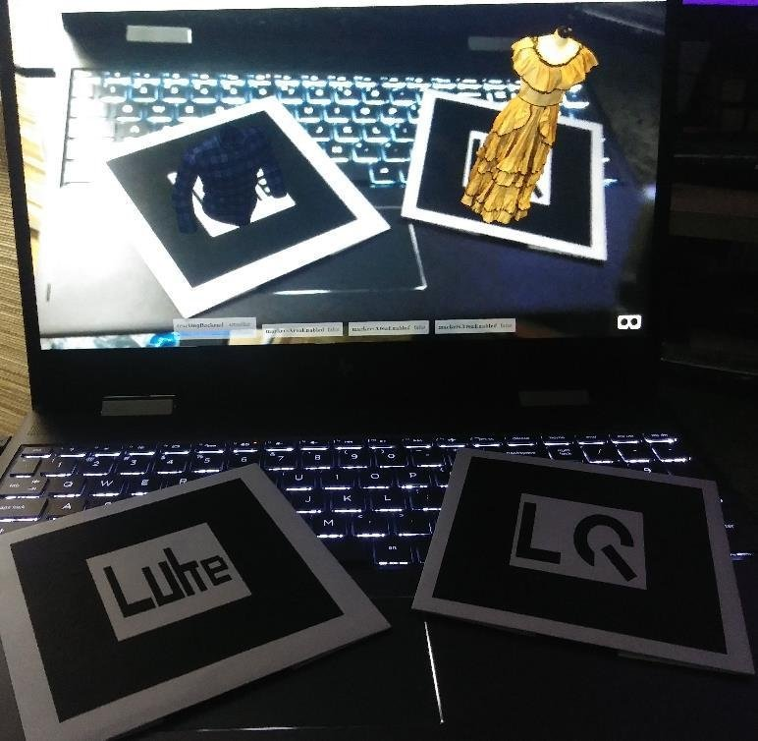
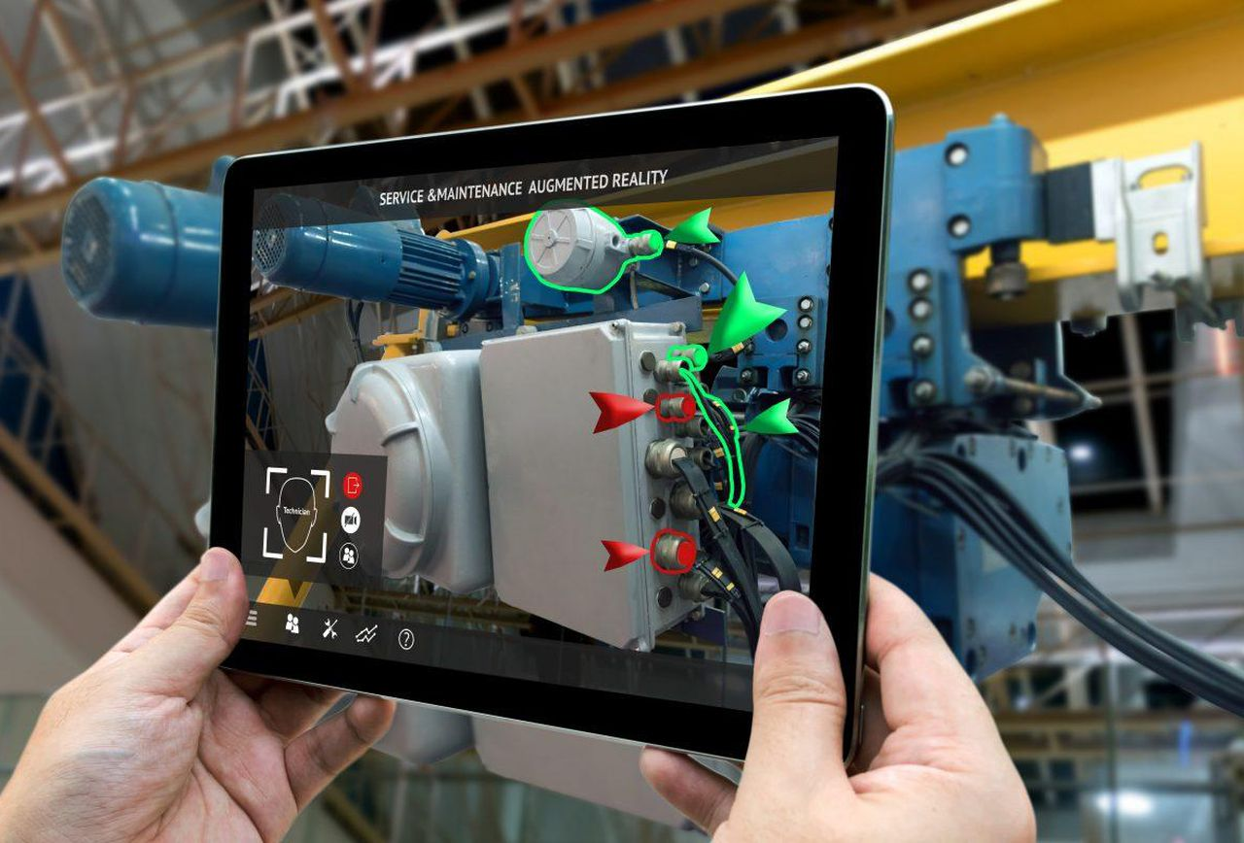
What is Augmented Reality (AR)?
A reality where computer generated models are overlapped into a user’s view of the real world.
User can interact with the model, but via the use of a marker, or through the use of the viewport.
Business card project: https://tinyurl.com/yccu8l35
Examples: Help Lightning, Continental HUD, I-Mechanic

Slide 6
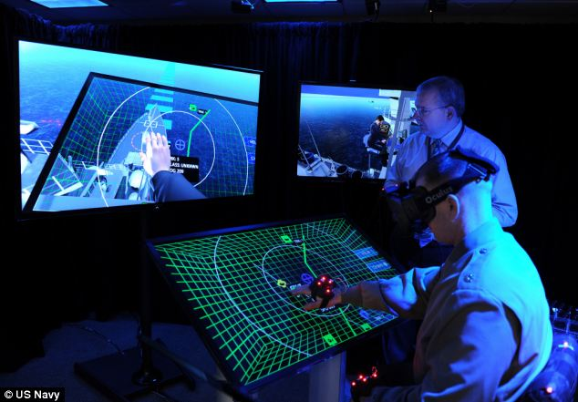
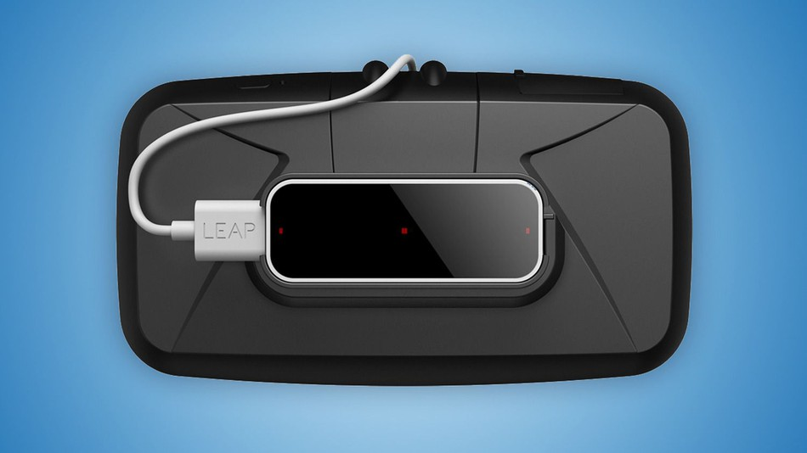
What is Virtual Reality (VR)?
A reality where the user is closed off from the real world and is put into an all virtual, simulated environment.
User can interact with the environment through the use of controllers or sensors that mimic/scan hand positions.
Examples: VR Vaccine

Slide 7
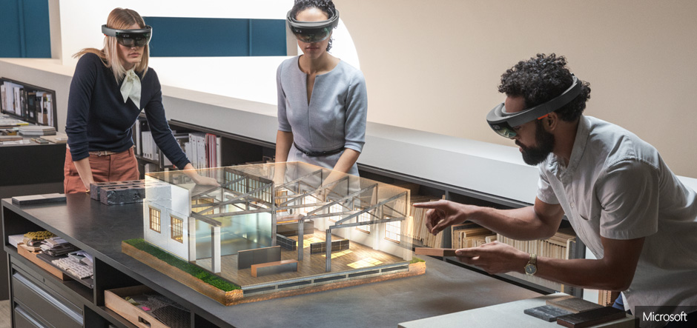
What is Mixed Reality (MR)?
The reality where both real world and digital elements come together.
Interaction and manipulation can be done in both the virtual and physical environment.
Image and sensing technologies allow user to interact using their hands and their front-facing FOV.

Slide 8
CyclePsych
Rachel St. Claire
Gwen Field, Tony Stracuzzi,
Lukas Garcia

Slide 9
Stress in Virtual Reality Update on March 15, 2018
Tony Stracuzzi
Lukas Garcia

Slide 10
Empathy in Virtual Reality Project on hold
Need new project leader

Slide 11
The Project
Investigate factors of empathy creation and stress levels that can occur within VR & desktop environments.
Big Questions:
Does the amount of time that’s taken into a personal user’s character creation have any effect on empathy and stress levels?
Does race in character creation have an impact upon the user when they are in virtual and/or desktop environments?

Slide 12
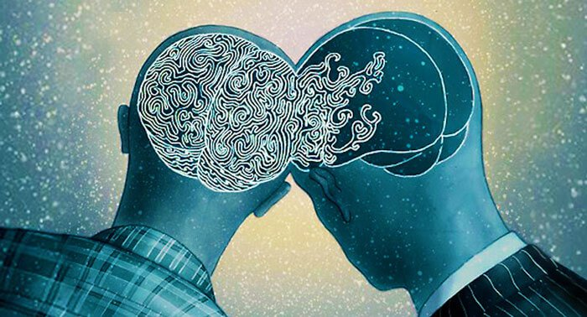
What is Empathy?
It is the capacity to understand or feel what another person, creature, being, etc. is experiencing from within a frame of reference.
The capacity to place oneself in another’s position and enact some sort of emotional state for that other being.

Slide 13
Generation of Empathy
An Impairment of Working Memory
Show a user a pattern
Does the image induce empathy?
Show user the pattern again
Can the user remember the pattern?
Objective way to measure empathy and see if a user can recollect pattern recognition.

Slide 14
Educational Mixed Reality Update on March 15, 2018
Vinny Macri
Trever X., Christian X.,
Miesha X.

Slide 15
The Project
Design multiple use applications for the newly released Magic Leap One.
Create an environment where a user can interact with a digital model of a brain and inspect the various components of the brain.
Enlarge and shrink the model
“Explode” the model to see various innards of a brain.
Rotate the model
Use other tools within the environment for better interaction and understanding of the model.

Slide 16
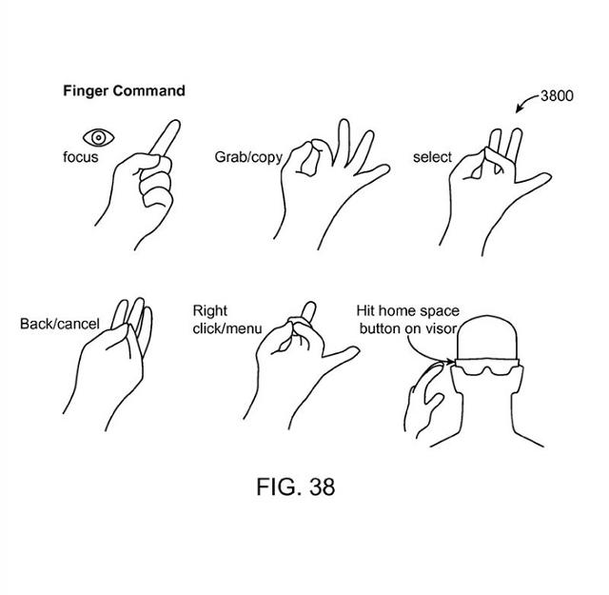
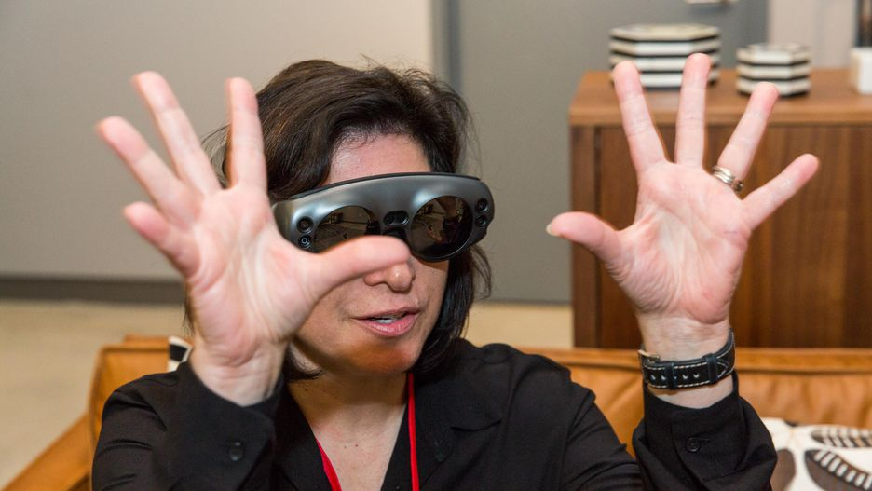
How?
Using the Magic Leap One, a user can interact with a computer-generated brain model with the use of their hands.
Pinch to shrink
Move hands away from each other to expand
Gesture to place the brain in the real world environment
The model is casted in front of the user’s FOV and a user can interact with the model at a whim.

Slide 17
Future Development Use
Mixed Reality headsets are going to be the newest and most upcoming use of XReality.
Ability for anyone to see beyond a real-world environment that was not possible before.
Possibility to bring VR versions of applications into MR.
Examples:
The Stanford Virtual Heart (Video)
Industrial SCADA Systems
Trimble Connect for Construction

Slide 18
Brief Update: S2019
New improved models
Better object and text occlusion
Improved rotation animation of brain

Slide 19
S.S.D.M. in VR
Lukas Garcia

Slide 20
The Project
Split-Second Decision Making in Virtual Reality
Paper testing versus virtual reality testing
Create an emphasis on testing human subjects in virtual reality and why it can be important for further research.

Slide 21
Problem & Solution
Hypothesis:
Can emotions and imagination cause different split-second decision making responses when tested on paper compared to that of a simulated scenario in VR?
Test Case:
Ask ethical questions both on paper and in virtual reality.
Ethical questions can be based on life and death situations; questions that really play a part on important decision making skills.
After sampling with paper, recreate dilemmas in VR where imagination is not needed.
Sample Questions:
Ethical Dilemmas
The Trolley Problem

Slide 22
Paper to VR
Main Issue:
Can a subject make a different split-second decision when the situation is presented to them compared to when a user must recreate the situation in their head?
Use VR to simulate and model the scenario without the subject needing to imagine what the scenario might be. Instead, the subject is in control of the question.
The subject can see facial features on a model
The subject is in “control” of the environment
Are questions still asked when in VR compared to that of paper testing?

Slide 23
Other Tests to Try
The Stroop Effect (What?)
A color’s name is printed in a different color than what it is describing.
Example: GREEN, BLUE, ORANGE, PURPLE
In VR:
Have users draw the names in different colors and test users on choices.
Have a user have to decide between buttons, one that is colored red, another that says RED.
Pavlov’s Dog/Classical Conditioning (What?)
The pairing of a biological potent stimulus to a neutral stimulus
In VR, simulate a way that a bell or sound can cause someone to do something without them knowing that they are doing it…maybe…
I’m not a psychologist, but I’m reading up on these tests!

Slide 24
VRmancer Work in Progress
Lukas Garcia

Slide 25
The Project
The creation of an artificial consciousness using data pulled from virtual reality testing.
Still a big work in progress
More of a private project.

Slide 26
XReality and the Future
The future has an unlimited source of possibilities for anyone in the XR environment.
You just have to believe it to make it a reality.
Questions:
Drop me an email at: lgarcia2013@fau.edu
Thank you, MPCR Lab!
“You can close your eyes to reality, but not to memories.”
~ Stanislaw Jerzy Lec

